Slide 1
Course Name :Cloud Computing Lab(CSL803)
Department: Computer Engineering
Semester: VIII
Div: B
Academic Year:2021-2022 (FH 2022)
Name of faculty- Mrs. Reshma Koli

Slide 2
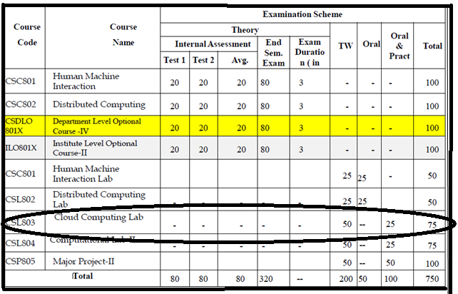
Course Scheme

Slide 3
Distribution of marks
Term Work: (50 marks)
Term work should consist of at least 6 experiments and a mini project.
Journal must include at least 2 assignments. .
The distribution of marks for term work shall be as follows:
Laboratory work (experiments)(10)+ Quiz(5): (15) Marks.
Assignments............................................................ (05) Marks
Attendance ………………………………………..... …… (05) Marks
Mini project.................... ………………………… ……. (10) Marks
Mini Project Presentation ------------------------ (05) Marks
Mini Project Report....................... …………………. (05) Marks
SalesForces Badges/Honeywell Certification (05) Marks
TOTAL: …………………………………………… (50) Marks.
Practical and Oral :( 25 marks)
Mini Project demonstration and Oral examination will be based on Laboratory work, mini project and above syllabus

Slide 4
Course Objectives And Outcomes
Lab Objectives:
The course will help the learners to get familiar with
1. Key concepts of virtualization.
2. Various deployment models such as private, public, hybrid and community.
3. Various service models such as IaaS and PaaS and SaaS.
4. Security and Privacy issues in cloud.
Lab Outcomes:
On completion of the course learners will be able to
1. To understand the architecture and services of cloud computing.
2. To understand and implement different types of virtualization and increase resource utilization.
3. To Demonstrate and Implement various service models (IaaS, PaaS, SaaS)
4. To analyze security issues on cloud and Implement Identity Access Management .
5. To develop real world web applications and deploy on commercial cloud.
6. To understand the concept of Fog Computing in relation with cloud computing.

Slide 5
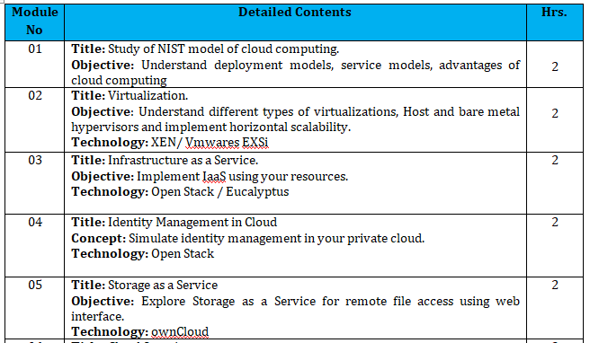
Course Syllabus

Slide 6
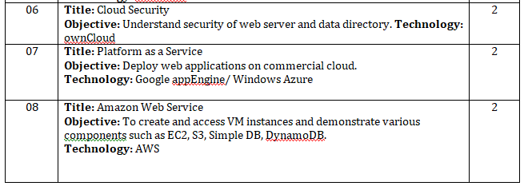
Course Syllabus

Slide 7
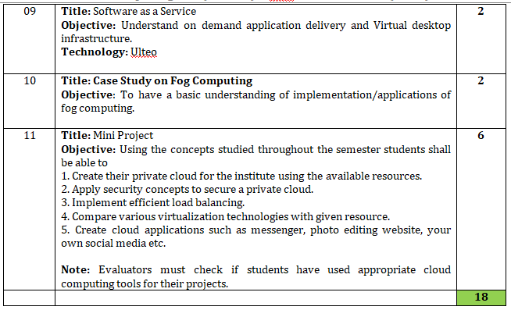
Course Syllabus

Slide 8
CCL Experiment List
Sr. No. | Title | LO mapping
1 | Study of NIST model of cloud computing. | LO1
2A | Implement Virtualization using VM-Ware | LO2
2B | Implement virtualization using Virtual-Box | LO2
3 | To demonstrate and implement Infrastructure as a Service (IAAS) using AWS EC2/Open-stack | LO3
4 | To demonstrate and implement Storage as a service using AWS S3 Service | LO3
5 | To demonstrate and implement Platform As a Service(PASS) using AWS S3 Service | LO3
6 | Deploy web applications on commercial cloud (PAAS)(AWS-Light Sail) | LO5
7 | Understand Security of Web Server and demonstration of IAM using own cloud/AWS | LO4
8 | To have a basic understanding of implementation/applications of fog computing. (Case study) | LO6
9 | Mini Project : Implement Cloud Based Application (i.e. integrate cloud services in application) | LO5

Slide 9
Introduction to Cloud Computing

Slide 10
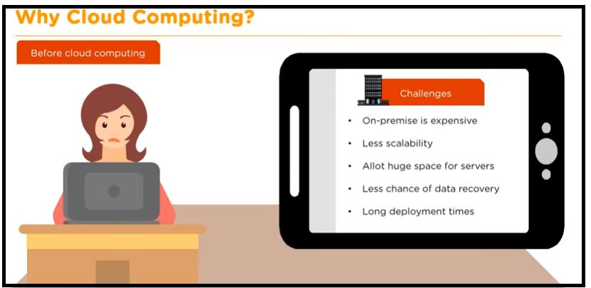
Why Cloud Computing

Slide 11
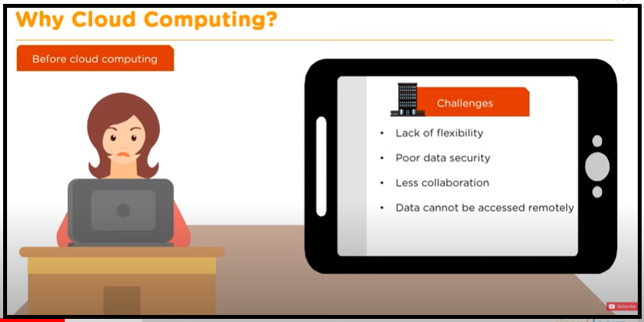
Why Cloud Computing

Slide 12
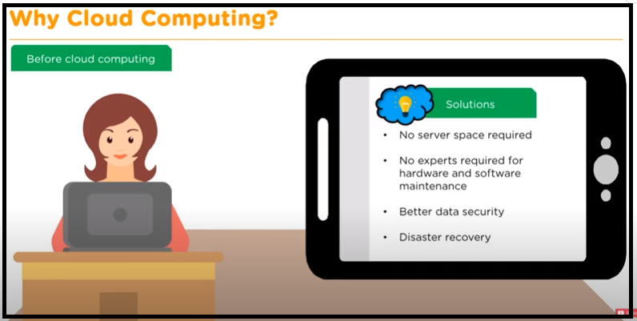
Why Cloud Computing

Slide 13

Why Cloud Computing

Slide 14
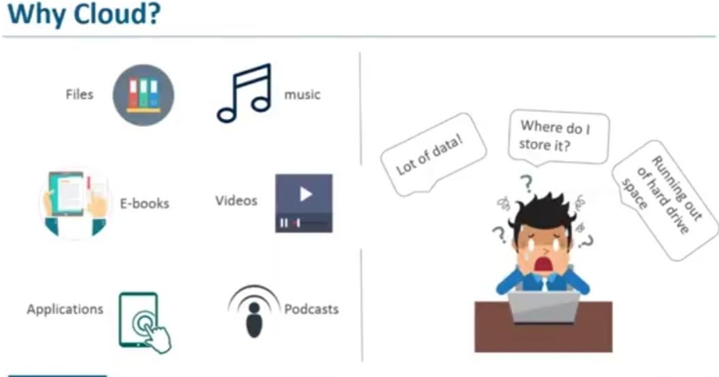
1. Introduction to Cloud Computing

Slide 15
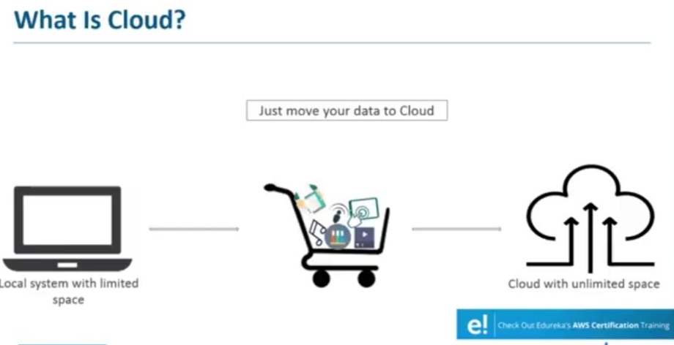
Introduction to Cloud Computing

Slide 16
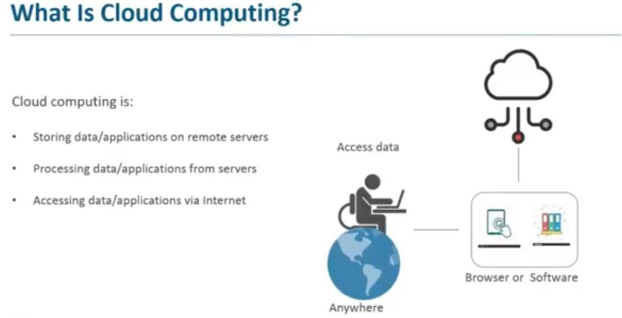
Introduction to Cloud Computing

Slide 17
Introduction to Cloud Computing
Cloud: Huge storage available over the internet, it consist of all networking resources.
Cloud which is a network of multiple devices, computers and servers connected to each other over the Internet.
Cloud computing is the dynamic delivery of IT resources (server, databases, software)and capabilities as a Service over the Internet. Cloud computing encompasses any Subscription-based or pay-per-use service that, in real time over the Internet.
cloud computing is the delivery of computing services—including servers, storage, databases, networking, software, analytics, and intelligence—over the Internet (“the cloud”)
Characteristics:
1. On-Demand Self-Service
2. Optimal Resource Utilization
3. Minimize licensing new software
4. Reduce capital costs
5. Improve accessibility
6. Resource Pooling
7. Rapid Elasticity

Slide 18
NIST Definition of Cloud Computing
Cloud computing is a model for enabling ubiquitous, convenient, on-demand network access to a shared pool of configurable computing resources (e.g., networks, servers, storage, applications, and services) that can be rapidly provisioned and released with minimal management effort or service provider interaction.
This cloud model is composed of five essential characteristics, three service models, and four deployment models.

Slide 19
NIST Definition of Cloud Computing
Essential Characteristics:
On-demand self-service. A consumer can unilaterally provision computing capabilities, such as server time and network storage, as needed automatically without requiring human interaction with each service provider.
Broad network access. Capabilities are available over the network and accessed through standard mechanisms that promote use by heterogeneous thin or thick client platforms (e.g., mobile phones, tablets, laptops, and workstations).
Resource pooling. The provider’s computing resources are pooled to serve multiple consumers using a multi-tenant model, with different physical and virtual resources dynamically assigned and reassigned according to consumer demand. There is a sense of location independence in that the customer generally has no control or knowledge over the exact location of the provided resources but may be able to specify location at a higher level of abstraction (e.g., country, state, or data enter). Examples of resources include storage, processing, memory, and network bandwidth.

Slide 20
NIST Definition of Cloud Computing
Rapid elasticity. Capabilities can be elastically provisioned and released, in some cases automatically, to scale rapidly outward and inward commensurate with demand. To the consumer, the capabilities available for provisioning often appear to be unlimited and can be appropriated in any quantity at any time.
Measured service. Cloud systems automatically control and optimize resource use by leveraging a metering capability1 at some level of abstraction appropriate to the type of service (e.g., storage, processing, bandwidth, and active user accounts). Resource usage can be monitored, controlled, and reported, providing transparency for both the provider and consumer of the utilized service. .

Slide 21
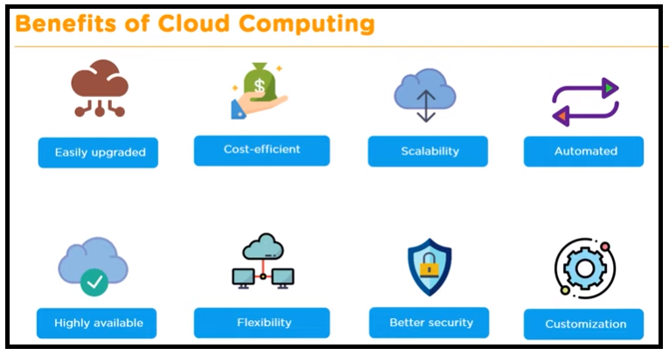
Benefits of Cloud Computing

Slide 22
Types of Cloud (Cloud Deployment Model)
Public cloud:
The cloud infrastructure is provisioned for open use by the general public. It may be owned, managed, and operated by a business, academic, or government organization, or some combination of them. It exists on the premises of the cloud provider.
Public cloud, in general, is SaaS services offered to users over the internet.
It is the most economical option for users in which the service provider bears the expenses of bandwidth and infrastructure.
It has limited configurations, and the cost is determined by usage capacity.
Despite high reliability, lower costs, zero maintenance and on-demand scalability, the public cloud is not suitable for organizations operating with sensitive information as they have to comply with stringent security regulations.

Slide 23
Types of Cloud (Cloud Deployment Model)
Private cloud:
The cloud infrastructure is provisioned for exclusive use by a single organization comprising multiple consumers (e.g., business units). It may be owned, managed, and operated by the organization, a third party, or some combination of them, and it may exist on or off premises.
As the name suggests, the private cloud is used by large organizations to build and manage their own data centers for specific business and IT needs/ operations.
The private cloud provides more control over customizability, scalability and flexibility, while improving security of assets and business operations.

Slide 24
Types of Cloud(Cloud Deployment Model)
Hybrid cloud:
The cloud infrastructure is a composition of two or more distinct cloud infrastructures (private, community, or public) that remain unique entities, but are bound together by standardized or proprietary technology that enables data and application portability (e.g., cloud bursting for load balancing between clouds).
Hybrid cloud is the combination of a private and public cloud, providing for more flexibility to businesses while having control over critical operations and assets, coupled with improved flexibility and cost efficiency.
The hybrid cloud architecture enables companies to take advantage of the public cloud as and when necessary due to their easy workload migration. For instance, businesses can use the public cloud for running high-volume applications like emails, and utilize private clouds for sensitive assets like financials, data recovery, and during scheduled maintenance and rise in demand.

Slide 25
Types of Cloud(Cloud Deployment Model)
Community cloud:
The cloud infrastructure is provisioned for exclusive use by a specific community of consumers from organizations that have shared concerns (e.g., mission, security requirements, policy, and compliance considerations). It may be owned, managed, and operated by one or more of the organizations in the community, a third party, or some combination of them, and it may exist on or off premises.

Slide 26
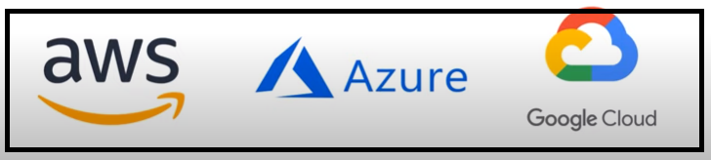
Popular Cloud Providers

Slide 27
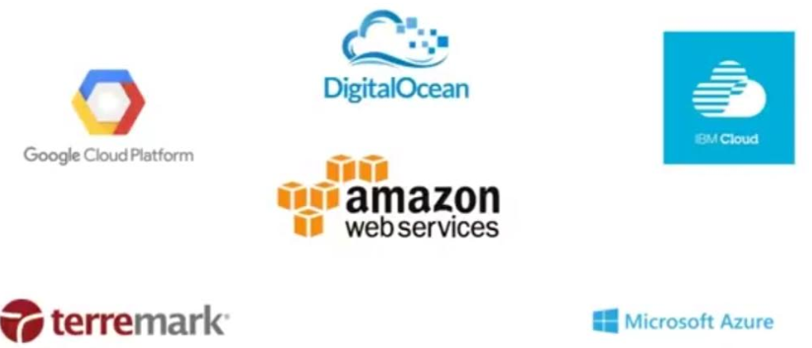
Cloud Providers

Slide 28
2. Cloud Providers
There are many Cloud Service providers in the market:
Amazon Web Service (AWS)
Microsoft Azure
Google Cloud Platform
IBM Cloud Services
Adobe Creative Cloud
Kamatera
VMware
Rackspace
Red Hat
Salesforce
Oracle Cloud
SAP
Verizon Cloud
Navisite
Dropbox

Slide 29
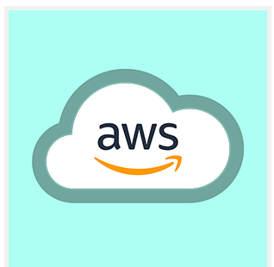
AWS
Amazon Web Services (AWS)
Amazon Web Services is a cloud computing platform which provides services such as compute power, database storage, content delivery and many other functions which will help to integrate a business. The Amazon Web Services is flexible, scalable, and reliable and due to this many companies are implementing it in their work. There is no upfront cost and the customer has to pay only for what they have used. It is one of the leading cloud service providers among all.

Slide 30
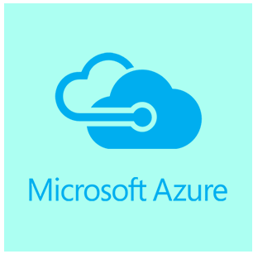
Microsoft Azure
Microsoft Azure is a cloud computing service which is used for building, testing, deploying and managing the application. This process is done in a global network of the Microsoft-managed data centre. It is private as well as a public cloud platform.
It uses virtualization which differentiates the coupling between the operating system and CPU with the help of an abstraction layer known as a hypervisor.
This hypervisor emulates all the functionality of the physical machine such as hardware and server into a virtual one. There is numerous amount of virtual machine available and each virtual machine can run many operating systems.

Slide 31
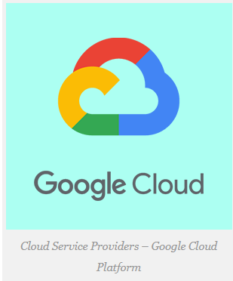
Google cloud
Google cloud platform is one of the leading Cloud Computing services which are offered by Google and it runs on the same infrastructure that Google uses for its end-user products.
The Google cloud platform is basically used for Google search and YouTube. There are various services offered by Google Cloud such as data analysis, machine learning, and data storage.
The data stored in Google Cloud is secure and can access easily. It offers varieties of services from infrastructure as a service to platform as a service. Google also provides a strong commitment to security and stability. With the help of the Google cloud platform, the user is free to think about the code and the feature which are needed to develop without worrying about the operations side.

Slide 32
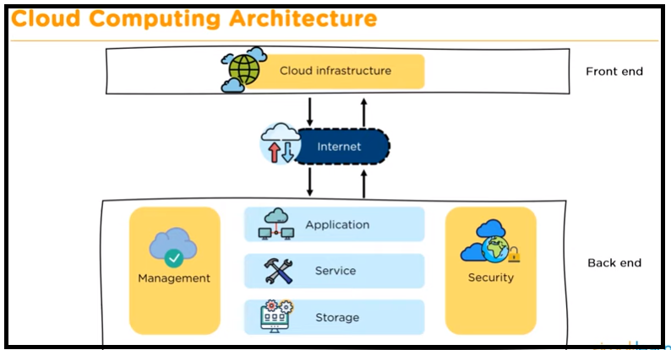
3. Cloud Computing Architecture

Slide 33
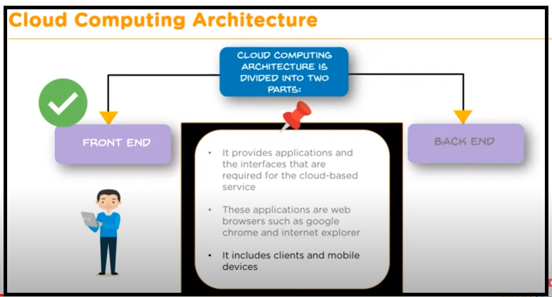
Cloud Computing Architecture

Slide 34
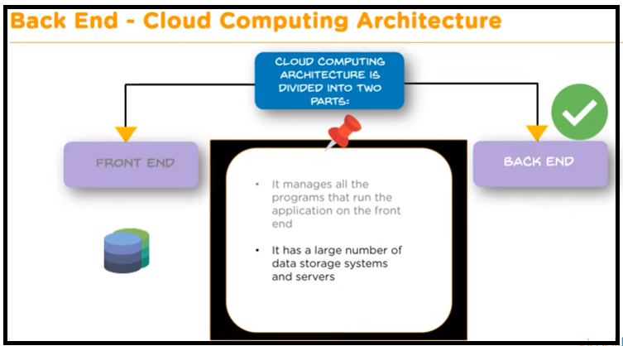
Cloud Computing Architecture

Slide 35
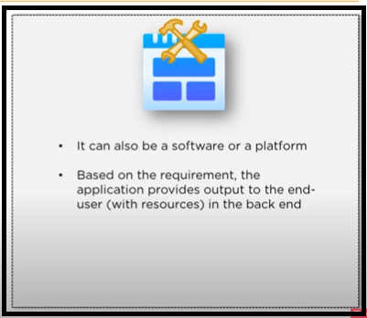
Cloud Computing Architecture (back-end)

Slide 36
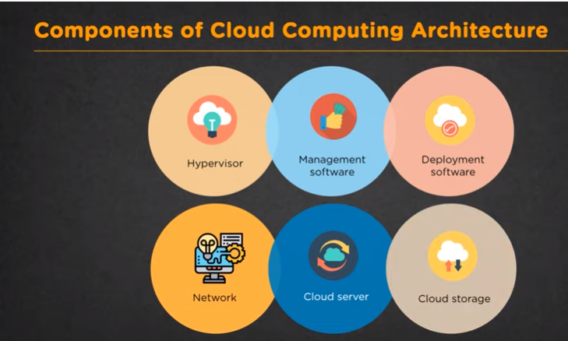
4. Components of Cloud Computing

Slide 37
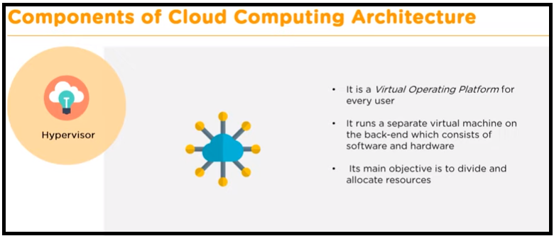
Components of Cloud Computing

Slide 38
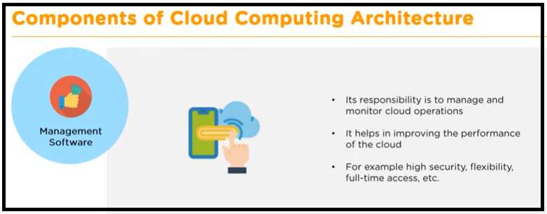
Components of Cloud Computing

Slide 39
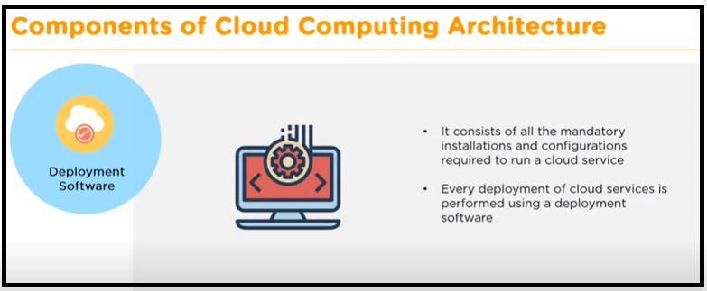
Components of Cloud Computing

Slide 40
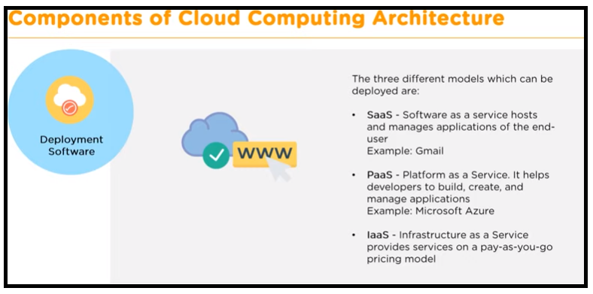
Components of Cloud Computing

Slide 41
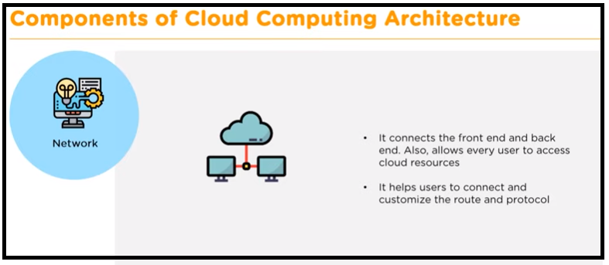
Components of Cloud Computing

Slide 42
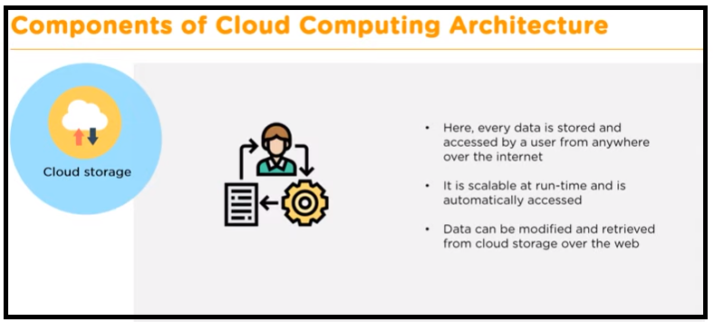
Components of Cloud Computing

Slide 43
5. Cloud Service Models
Software-as-a-service (SaaS): The capability provided to the consumer is to use the provider’s applications running on a cloud infrastructure2. The applications are accessible from various client devices through either a thin client interface, such as a web browser (e.g., web-based email), or a program interface. The consumer does not manage or control the underlying cloud infrastructure including network, servers, operating systems, storage, or even individual application capabilities, with the possible exception of limited user-specific application configuration settings
Saas is a cloud service provided by the cloud company. In SaaS, a cloud providers provides software which can be either for a particular amount of time or for the lifetime.
SaaS utilizes the internet and delivers the application to the customer. Most of the SaaS application does not require any downloads as they can use directly through the web browser.
Example: G-Mail

Slide 44
Cloud Service Models
2. Platform-as-a-service (PaaS): The capability provided to the consumer is to deploy onto the cloud infrastructure consumer-created or acquired applications created using programming languages, libraries, services, and tools supported by the provider.3 The consumer does not manage or control the underlying cloud infrastructure including network, servers, operating systems, or storage, but has control over the deployed applications and possibly configuration settings for the application-hosting environment .
It is a development environment where a customer can create and develop applications on a provider’s computing environment.
Paas is a framework for the developer where they can create an application for customizing the previously built application. This service also provided through the means of internet and here all the management is done by the enterprise or any third party provider.
Example: Google App Engine

Slide 45
Cloud Service Models
3. Infrastructure e-as-a-service (SaaS): The capability provided to the consumer is to provision processing, storage, networks, and other fundamental computing resources where the consumer is able to deploy and run arbitrary software, which can include operating systems and applications. The consumer does not manage or control the underlying cloud infrastructure but has control over operating systems, storage, and deployed applications; and possibly limited control of select networking components (e.g., host firewalls) .Where infrastructure is provided to you , you can create your own applications. i.e. underlying architecture is available where you can choose kind of technology , applications you want.
Example: AWS EC2 service

Slide 46
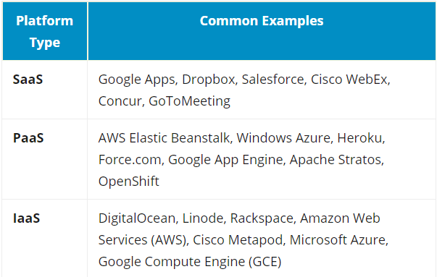
Saas , Paas, Iaas Examples

Slide 47
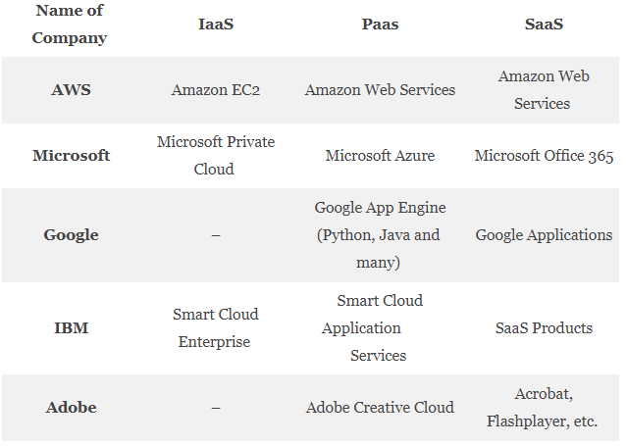
Services Provided by Cloud Providers

Slide 48
Introduction to Virtualization

Slide 49
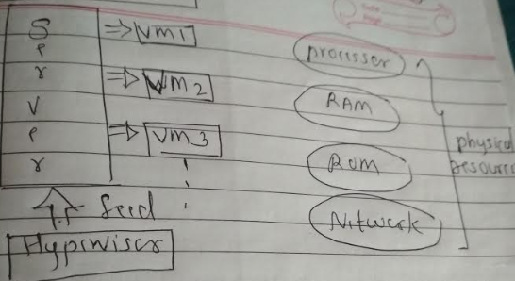
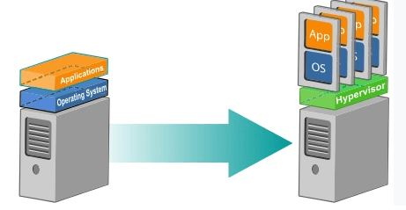
6. Virtualization

Slide 50
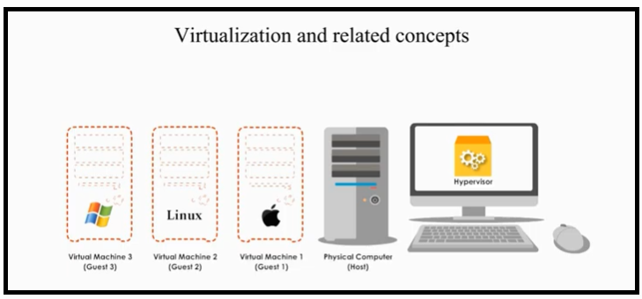
Virtualization

Slide 51
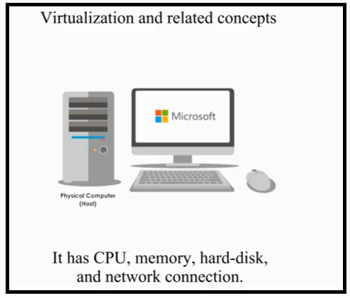
Virtualization

Slide 52
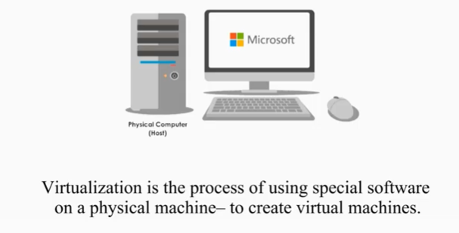






Virtualization

Slide 53
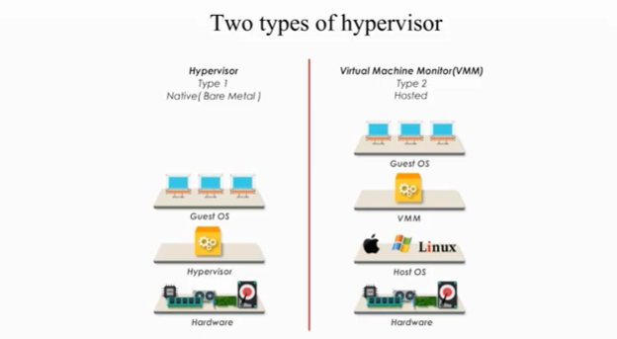





Virtualization

Slide 54
Types of Hypervisors
Type 1: Bare metal
Run directly on the top of the host hardware, they control hardware and manage virtual machines
Type 2: Hosted Hypervisor
Referred as VMM, it is an application program running on the top of the OS
Virtual machines are created and managed by VMM through host OS

Slide 55
Virtualization
Example of Hosted Hypervisor

Slide 56
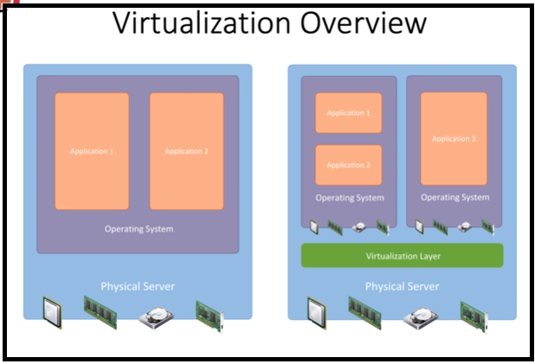
Virtualization

Slide 57
Virtualization
Physical server has physical devices
CPU
Memory
Disc
NIC
On the Top of physical server there is OS , on which multiple applications are running

Slide 58
Virtualization
Virtualization: virtualization in cloud computing is making a virtual image of the storage devices ,servers or network resources so that they can be used on multiple machines at the same time. There are many positive and negative effects of virtualization technology on the environment as well as the business and IT field.
In technology virtualization means, virtual version of something is created and used regardless of the original version. This could be anything from operating systems, servers, storage devices and networks. One such example is partitioning a hard drive.
Virtualization is the "creation of a virtual (rather than actual) version of something, such as a server, a desktop, a storage device, an operating system or network resources".
We can define Virtualization as a technology that provides the capability to logically separate the physical resources of a server and use them as different isolated machines, called Virtual Machines.
Previously, there were computers that ran an Operating System (OS) and application on top of the OS, but now, with the help of virtualization software like Hypervisor, one can create multiple Virtual Machines (VMs) on a single computer and install OS on them and run all of them at the same time.

Slide 59
Virtualization
Advantages of Virtualization:
Virtualization in Cloud Computing, save the cost for a physical system such as hardware and servers. It stores all the data in the virtual server, which are quite economical. It reduces the wastage, decreases the electricity bills along with the maintenance cost.
Reduced capital and operating costs.
Minimized or eliminated downtime.
Increased IT productivity, efficiency, agility and responsiveness.
Faster provisioning of applications and resources.
Greater business continuity and disaster recovery.
Simplified data center management.

Slide 60
Virtualization
Disadvantages of Virtualization
It can have a high cost of implementation. ...
It still has limitations. ...
It creates a security risk. ...
It creates an availability issue. ...
It creates a scalability issue. ...
It requires several links in a chain that must work together cohesively. ...
It takes time.
Software licensing costs.
The necessity to train IT, staff, in virtualization.

Slide 61
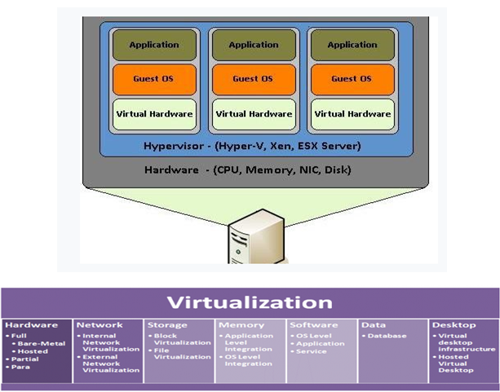
Virtualization

Slide 62
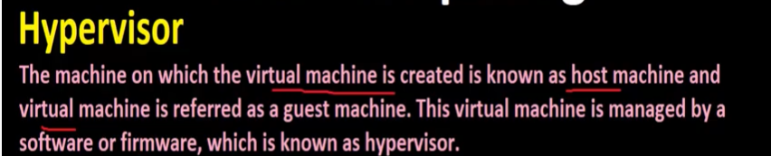
Virtualization

Slide 63
AWS

Slide 64
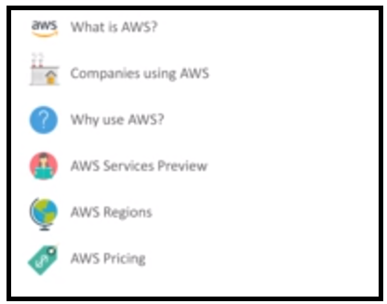
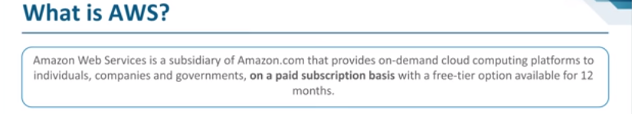
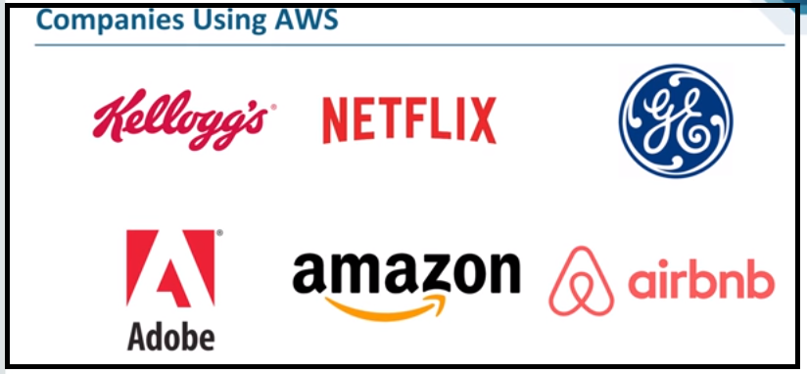
7. AWS

Slide 65
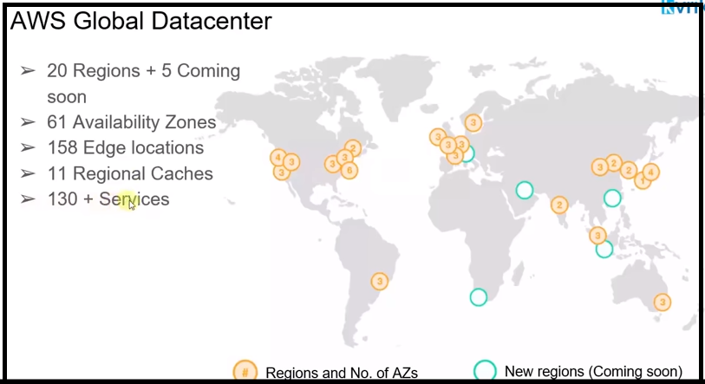
AWS

Slide 66
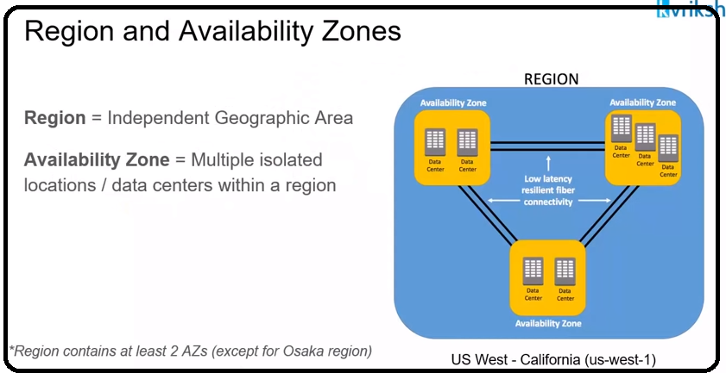
AWS

Slide 67
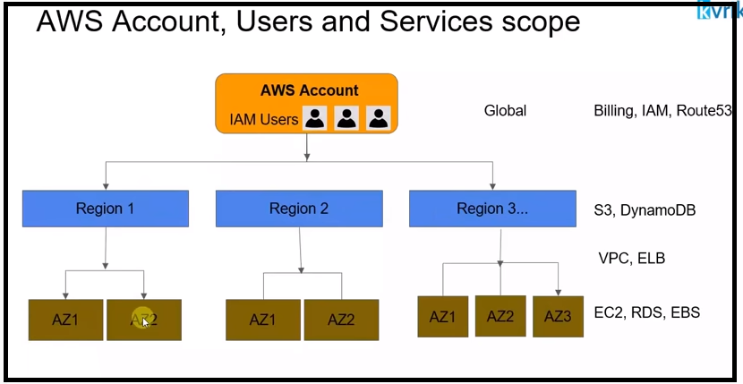
AWS
Once you have an AWS account , you can deploy your infrastructure on any region

Slide 68
AWS
AWS Account: Once you have an AWS account , you can deploy your infrastructure on any region.
Billing Service: Works at account level and at the end of the month you will get bill
IAM (Identity Access Management) : Works at account level , you can create different users and that users can use AWS services
S3 and DynamoDB Service: Works at region level
EC2(Elastic Compute Cloud):
RDS : (Database)
EBS : (Elastic Block storage)

Slide 69
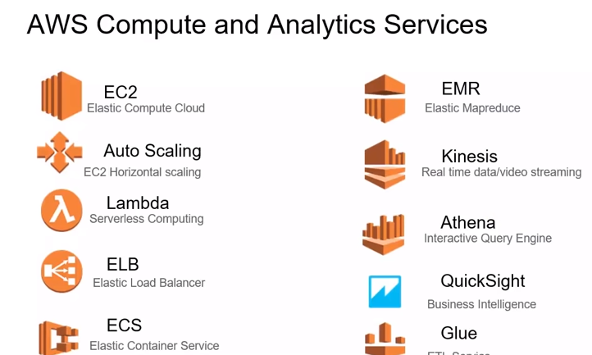
AWS SERVICES

Slide 70
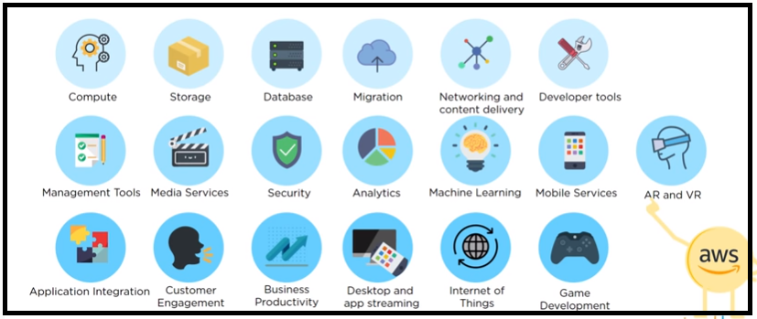
AWS SERVICES

Slide 71
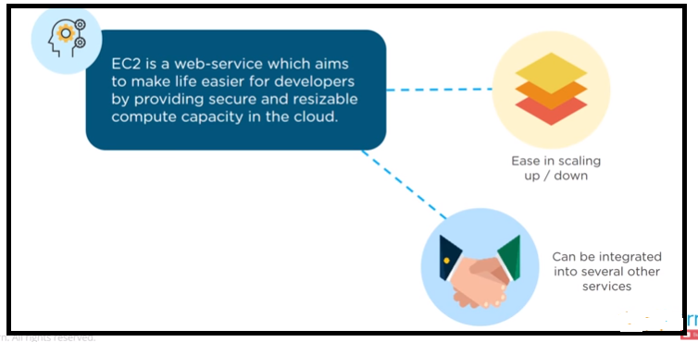
AWS SERVICES

Slide 72
8. Ulteo
It is Open Virtual Desktop (OVD) was an open-source Application Delivery and Virtual Desktop infrastructure project that could deliver applications or a desktop hosted on a Linux or Windows server to end users.

Slide 73
9. AWS Identity and Access Management (IAM)
AWS Identity and Access Management (IAM) is a web service that helps you securely control access to AWS resources.
You use IAM to control who is authenticated (signed in) and authorized (has permissions) to use resources.
When you ﬁrst create an AWS account, you begin with a single sign-in identity that has complete access to all AWS services and resources in the account. This identity is called the AWS account root user and is accessed by signing in with the email address and password that you used to create the account.
We strongly recommend that you do not use the root user for your everyday tasks, even the administrative ones. Instead, adhere to the best practice of using the root user only to create your ﬁrst IAM user. Then securely lock away the root user credentials and use them to perform only a few account and service management tasks.
You can grant other people permission to administer and use resources in your AWS account without having to share your password or access key.

Slide 74
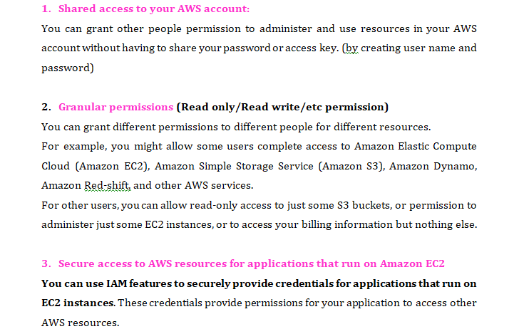
AWS IAM Features

Slide 75
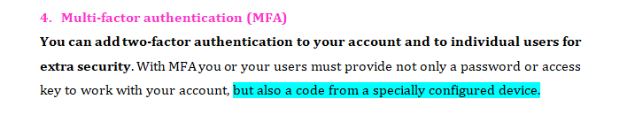
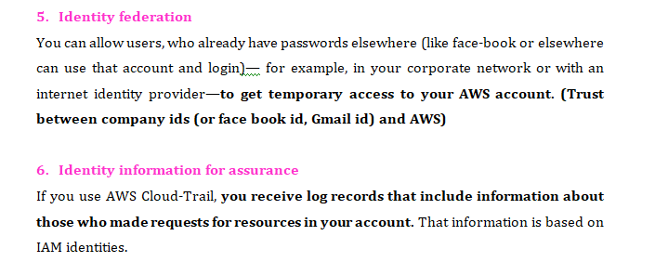
AWS IAM Features

Slide 76

AWS IAM Features

Slide 77

AWS IAM Features

Slide 78

AWS IAM Components

Slide 79

AWS IAM Components

Slide 80


10. Fog Computing(Distributed computing)
In IOT multiple devices are connected to each other and generating huge data, if we send this data on cloud for storage or analysis then it will cost very huge (that is huge data is send to cloud unnecessarily). Hence data is send to the intermediate devices present over the network for analysis, communication. That is in fog computing data is stored ,analysed at local level (having computing power). Bandwidth is saved because data is computed at local level.

Slide 81


Fog Computing(Distributed computing)
Fog computing is designed to be deployed in a distributed manner where edge de-vices do the processing.
In contrast, cloud computing is a more centralized concept.
In Fog, processing and storage devices are located in close proximity compared to the cloud and this is the reason why Fog is more capable to serve latency aware services through access points, smart phones, base stations, switches, servers, and routers.
Devices are IOT devices and data send to fog devices ; where they do some processing and then it sends to cloud.

Slide 82

Fog Computing(Distributed computing)

Slide 83
Fog Computing
The main difference between fog computing and cloud computing is that cloud is a centralized system, while the fog is a distributed decentralized infrastructure.
Fog computing is a mediator between hardware and remote servers.
cloud and fog computing both offer end users data, storage, computation and application services, but fog computing is in much closer proximity to end users and better supports mobility.
To be clear, fog computing will not replace cloud computing altogether; rather, it's a supplement to the cloud.
Fog and cloud computing are interconnected. In nature, fog is closer to the earth than clouds; in the technological world, it is just the same, fog is closer to end-users, bringing cloud capabilities down to the ground.

Slide 84
11. Conclusion
Cloud Computing is helping a lot in business whether it is a small or large.
These Cloud Service Providers companies provide storage, database server, networking and the software through which the business can increase.
So a customer can choose the company which is most suitable for their business and their requirement.

Slide 85
CCL Mini Project Guidelines
To prepare CCL mini project report, use same format as per your final year project report format
Prepare 5 mins video of project demonstration
Prepare ppt of CCL project and upload on Google classroom
Upload soft copy of report on Google classroom

Slide 86

Google App Engine

Slide 87

Google App Engine

Slide 88

Google App Engine

Slide 89

Google App Engine

